Slide 1

Developer technology trends
Dakshesh Gautam
10 October 2026
IBM Data Analyst Capstone
Notes:
IBM Data Analyst capstone. Survey: https://cf-courses-data.s3.us.cloud-object-storage.appdomain.cloud/VYPrOu0Vs3I0hKLLjiPGrA/survey-data-with-duplicate.csv
2024 Stack Overflow Developer Survey course copy. Source license: Open Database License. Analysis developed with AI assistance. Current and future-interest questions permit multiple choices. Percentages use all 65,437 unique respondents. Notebook and aggregate CSVs accompany this report.

Slide 2

OUTLINE
Executive summary
Introduction and methodology
Collection and survey results
Dashboard views
Discussion and implications
Conclusion and appendix
Notes:
IBM Data Analyst capstone. Survey: https://cf-courses-data.s3.us.cloud-object-storage.appdomain.cloud/VYPrOu0Vs3I0hKLLjiPGrA/survey-data-with-duplicate.csv
2024 Stack Overflow Developer Survey course copy. Source license: Open Database License. Analysis developed with AI assistance. Current and future-interest questions permit multiple choices. Percentages use all 65,437 unique respondents. Notebook and aggregate CSVs accompany this report.

Slide 3

EXECUTIVE SUMMARY
65,437 unique respondents remain after removing 20 duplicate rows.
JavaScript leads current language use at 57.3%. Python leads future interest at 38.3%.
PostgreSQL leads both database rankings.
These preferences describe a voluntary survey sample.
Notes:
IBM Data Analyst capstone. Survey: https://cf-courses-data.s3.us.cloud-object-storage.appdomain.cloud/VYPrOu0Vs3I0hKLLjiPGrA/survey-data-with-duplicate.csv
2024 Stack Overflow Developer Survey course copy. Source license: Open Database License. Analysis developed with AI assistance. Current and future-interest questions permit multiple choices. Percentages use all 65,437 unique respondents. Notebook and aggregate CSVs accompany this report.

Slide 4

INTRODUCTION
Purpose
Compare current technology use with developers’ stated future interests.
Audience
Data analysts and teams planning skills development.
Value
Identify common technologies and compare preferences with the separate job and salary exercises.
Notes:
IBM Data Analyst capstone. Survey: https://cf-courses-data.s3.us.cloud-object-storage.appdomain.cloud/VYPrOu0Vs3I0hKLLjiPGrA/survey-data-with-duplicate.csv
2024 Stack Overflow Developer Survey course copy. Source license: Open Database License. Analysis developed with AI assistance. Current and future-interest questions permit multiple choices. Percentages use all 65,437 unique respondents. Notebook and aggregate CSVs accompany this report.

Slide 5

METHODOLOGY
Collect the course jobs JSON through a local REST API and extract the salary HTML table.
Load 65,457 survey rows across 114 fields. Remove 20 exact duplicates.
Keep unanswered fields missing. Count each technology once per respondent.
Use positive compensation responses for the median. Apply an IQR filter only to its histogram.
Notes:
IBM Data Analyst capstone. Survey: https://cf-courses-data.s3.us.cloud-object-storage.appdomain.cloud/VYPrOu0Vs3I0hKLLjiPGrA/survey-data-with-duplicate.csv
2024 Stack Overflow Developer Survey course copy. Source license: Open Database License. Analysis developed with AI assistance. Current and future-interest questions permit multiple choices. Percentages use all 65,437 unique respondents. Notebook and aggregate CSVs accompany this report.
Jobs: https://cf-courses-data.s3.us.cloud-object-storage.appdomain.cloud/IBM-DA0321EN-SkillsNetwork/labs/module%201/Accessing%20Data%20Using%20APIs/jobs.json
Salary exercise: https://cf-courses-data.s3.us.cloud-object-storage.appdomain.cloud/IBM-DA0321EN-SkillsNetwork/labs/datasets/Programming_Languages.html
Local API reproduces the course’s case-sensitive substring matching. Bounded case-insensitive matching appears as a comparison. Exact duplicate removal leaves unique ResponseId values.

Slide 6
RESULTS
Collection exercises and technology preferences
27,005 modified job records
10 rows in the salary exercise
65,437 unique survey respondents
Notes:
IBM Data Analyst capstone. Survey: https://cf-courses-data.s3.us.cloud-object-storage.appdomain.cloud/VYPrOu0Vs3I0hKLLjiPGrA/survey-data-with-duplicate.csv
2024 Stack Overflow Developer Survey course copy. Source license: Open Database License. Analysis developed with AI assistance. Current and future-interest questions permit multiple choices. Percentages use all 65,437 unique respondents. Notebook and aggregate CSVs accompany this report.

Slide 7
JOB POSTINGS
Course API matching
C: 13,498 matches
Java: 2,609
Python: 1,173
Substring matching can combine distinct technologies. The CSV also provides a bounded comparison.
Source: modified course jobs dataset, 27,005 records. Counts reflect course API substring matching.
Notes:
Source: https://cf-courses-data.s3.us.cloud-object-storage.appdomain.cloud/IBM-DA0321EN-SkillsNetwork/labs/module%201/Accessing%20Data%20Using%20APIs/jobs.json
CourseMatches uses the supplied case-sensitive substring rule. BoundedMatches uses case-insensitive word boundaries. C course/bounded: 13,498/961. Java: 2,609/1,601. These modified teaching records do not establish current job demand. Descending counts.

Slide 8
POPULAR LANGUAGES
Salary HTML exercise
Swift: $130,801
Python: $114,383
C++: $113,865
The supplied table omits its sample size, survey date and methodology.
Source: supplied HTML salary table. Exercise values in USD, separate from survey compensation.
Notes:
Source: https://cf-courses-data.s3.us.cloud-object-storage.appdomain.cloud/IBM-DA0321EN-SkillsNetwork/labs/datasets/Programming_Languages.html
Extracted ten rows from the provided course HTML. These values lack a stated sample size, date and methodology. They do not estimate future earnings. Descending values.

Slide 9
PROGRAMMING LANGUAGE TRENDS
JavaScript leads current use. Python leads stated future interest.
Respondent counts, top ten in each ranking. Multiple selections allowed. Unique respondents: 65,437.
Notes:
IBM Data Analyst capstone. Survey: https://cf-courses-data.s3.us.cloud-object-storage.appdomain.cloud/VYPrOu0Vs3I0hKLLjiPGrA/survey-data-with-duplicate.csv
2024 Stack Overflow Developer Survey course copy. Source license: Open Database License. Analysis developed with AI assistance. Current and future-interest questions permit multiple choices. Percentages use all 65,437 unique respondents. Notebook and aggregate CSVs accompany this report.

Slide 10
LANGUAGE FINDINGS & IMPLICATIONS
Findings
Implications
JavaScript: 37,492 current users (57.3%).
Python: 25,047 future-interest mentions (38.3%).
SQL ranks among the four most common choices in both questions.
Python and SQL provide relevant foundations for data analysis.
JavaScript remains relevant to web work.
Compare preferences with actual team needs before choosing a learning plan.
Notes:
IBM Data Analyst capstone. Survey: https://cf-courses-data.s3.us.cloud-object-storage.appdomain.cloud/VYPrOu0Vs3I0hKLLjiPGrA/survey-data-with-duplicate.csv
2024 Stack Overflow Developer Survey course copy. Source license: Open Database License. Analysis developed with AI assistance. Current and future-interest questions permit multiple choices. Percentages use all 65,437 unique respondents. Notebook and aggregate CSVs accompany this report.

Slide 11
DATABASE TRENDS
PostgreSQL leads current use and future interest.
Respondent counts, top ten in each ranking. Multiple selections allowed. Unique respondents: 65,437.
Notes:
IBM Data Analyst capstone. Survey: https://cf-courses-data.s3.us.cloud-object-storage.appdomain.cloud/VYPrOu0Vs3I0hKLLjiPGrA/survey-data-with-duplicate.csv
2024 Stack Overflow Developer Survey course copy. Source license: Open Database License. Analysis developed with AI assistance. Current and future-interest questions permit multiple choices. Percentages use all 65,437 unique respondents. Notebook and aggregate CSVs accompany this report.

Slide 12
DATABASE FINDINGS & IMPLICATIONS
Findings
Implications
PostgreSQL: 25,536 current users and 24,005 future-interest mentions.
SQLite ranks second in future interest.
Redis interest exceeds current use by 384 mentions.
SQL and relational database skills fit the most common preferences.
PostgreSQL offers a relevant practice environment.
Selection also depends on workload and operating requirements.
Notes:
IBM Data Analyst capstone. Survey: https://cf-courses-data.s3.us.cloud-object-storage.appdomain.cloud/VYPrOu0Vs3I0hKLLjiPGrA/survey-data-with-duplicate.csv
2024 Stack Overflow Developer Survey course copy. Source license: Open Database License. Analysis developed with AI assistance. Current and future-interest questions permit multiple choices. Percentages use all 65,437 unique respondents. Notebook and aggregate CSVs accompany this report.

Slide 13

DASHBOARD
Three interactive portfolio views
Current Technology Usage
Future Technology Trends
Demographics
The accompanying HTML uses Plotly.
Portfolio dashboard. Course platform requirements and graded submission remain unverified.
Notes:
IBM Data Analyst capstone. Survey: https://cf-courses-data.s3.us.cloud-object-storage.appdomain.cloud/VYPrOu0Vs3I0hKLLjiPGrA/survey-data-with-duplicate.csv
2024 Stack Overflow Developer Survey course copy. Source license: Open Database License. Analysis developed with AI assistance. Current and future-interest questions permit multiple choices. Percentages use all 65,437 unique respondents. Notebook and aggregate CSVs accompany this report.

Slide 14
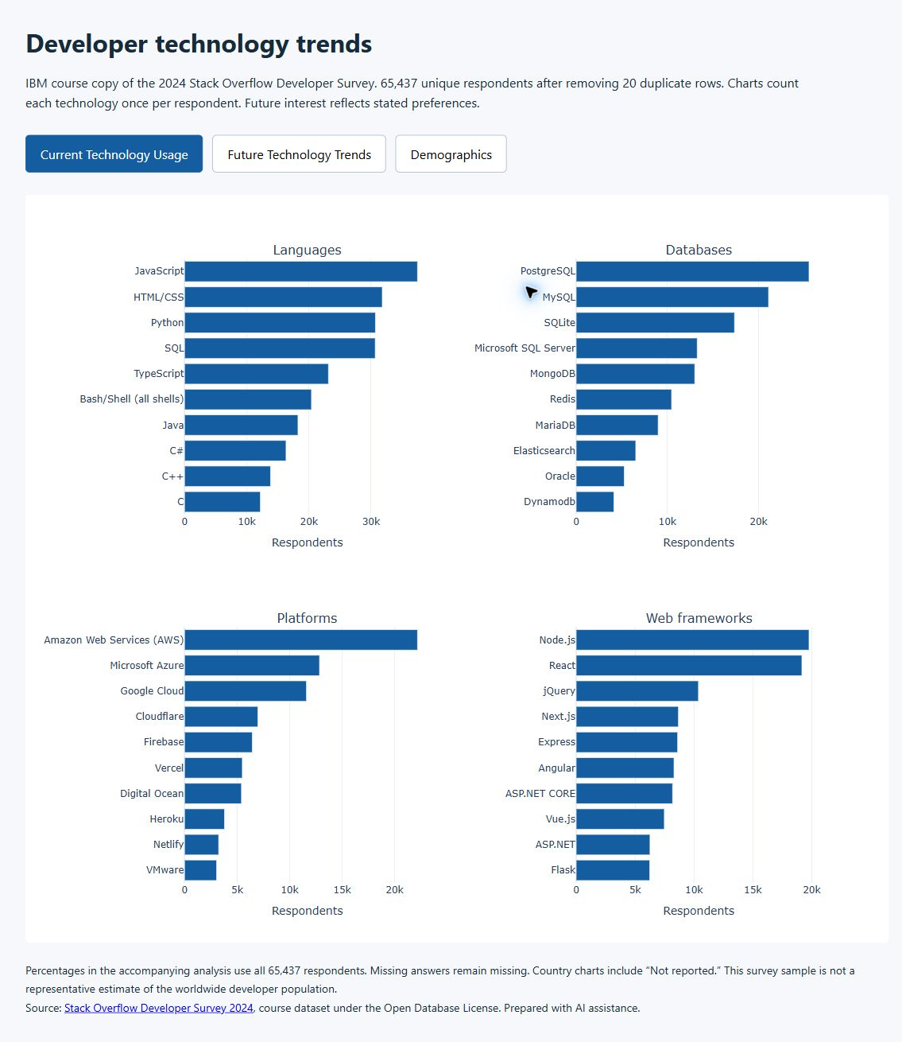
CURRENT TECHNOLOGY USAGE
JavaScript leads languages with 37,492 mentions.
PostgreSQL leads databases with 25,536 mentions.
AWS leads platforms. Node.js leads current web frameworks.
Screenshot of the accompanying local Plotly dashboard. Interactive charts and full labels are in dashboard.html.
Notes:
IBM Data Analyst capstone. Survey: https://cf-courses-data.s3.us.cloud-object-storage.appdomain.cloud/VYPrOu0Vs3I0hKLLjiPGrA/survey-data-with-duplicate.csv
2024 Stack Overflow Developer Survey course copy. Source license: Open Database License. Analysis developed with AI assistance. Current and future-interest questions permit multiple choices. Percentages use all 65,437 unique respondents. Notebook and aggregate CSVs accompany this report.
Dashboard screenshot captured in Chrome. This is the project’s local Plotly portfolio dashboard. It is not a Cognos or Google Looker report.

Slide 15
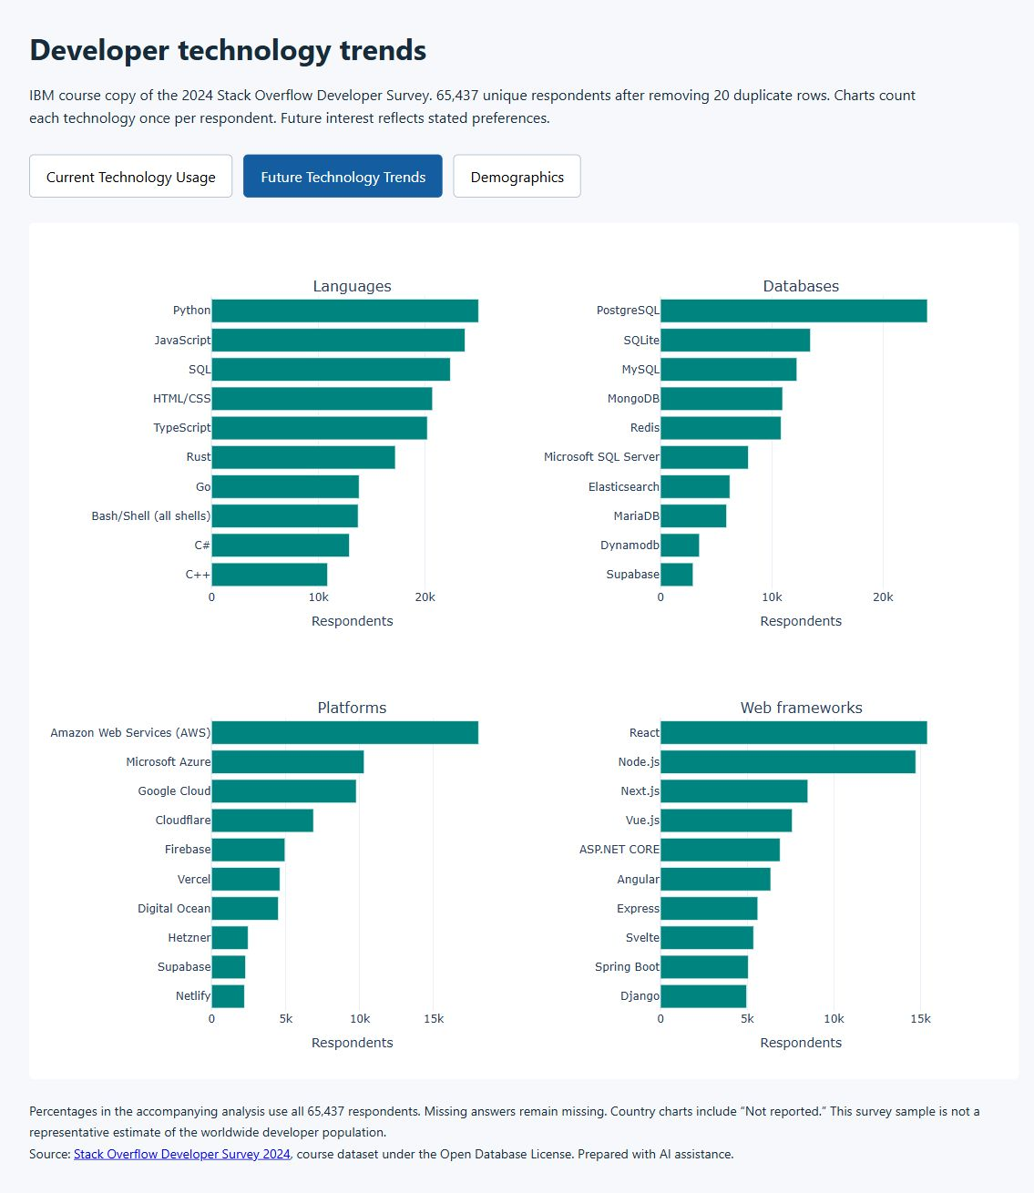
FUTURE TECHNOLOGY TRENDS
Python leads languages with 25,047 mentions.
PostgreSQL leads databases with 24,005 mentions.
React leads future interest among web frameworks.
Screenshot of the accompanying local Plotly dashboard. Interactive charts and full labels are in dashboard.html.
Notes:
IBM Data Analyst capstone. Survey: https://cf-courses-data.s3.us.cloud-object-storage.appdomain.cloud/VYPrOu0Vs3I0hKLLjiPGrA/survey-data-with-duplicate.csv
2024 Stack Overflow Developer Survey course copy. Source license: Open Database License. Analysis developed with AI assistance. Current and future-interest questions permit multiple choices. Percentages use all 65,437 unique respondents. Notebook and aggregate CSVs accompany this report.
Dashboard screenshot captured in Chrome. This is the project’s local Plotly portfolio dashboard. It is not a Cognos or Google Looker report.

Slide 16
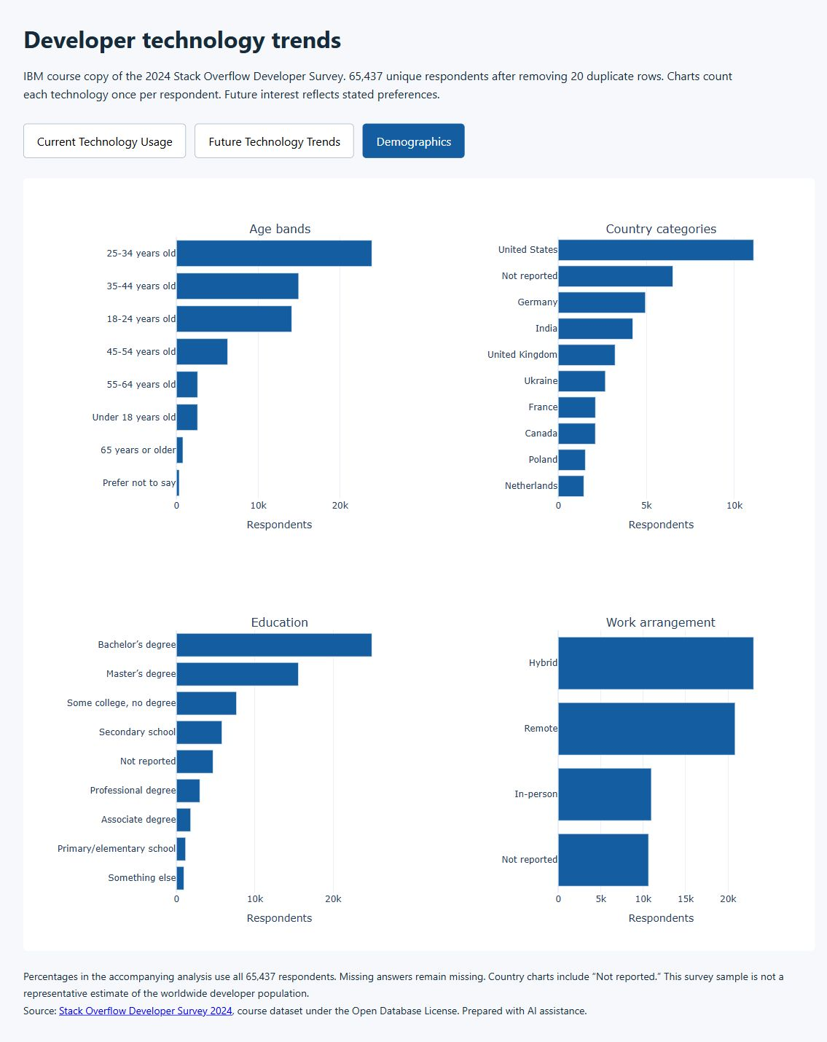
RESPONDENT DEMOGRAPHICS
The largest age band is 25–34 with 23,911 respondents (36.5%).
185 countries have reported responses. Another 6,507 respondents omit country.
Missing answers remain visible in the charts.
Screenshot of the accompanying local Plotly dashboard. Interactive charts and full labels are in dashboard.html.
Notes:
IBM Data Analyst capstone. Survey: https://cf-courses-data.s3.us.cloud-object-storage.appdomain.cloud/VYPrOu0Vs3I0hKLLjiPGrA/survey-data-with-duplicate.csv
2024 Stack Overflow Developer Survey course copy. Source license: Open Database License. Analysis developed with AI assistance. Current and future-interest questions permit multiple choices. Percentages use all 65,437 unique respondents. Notebook and aggregate CSVs accompany this report.
Dashboard screenshot captured in Chrome. This is the project’s local Plotly portfolio dashboard. It is not a Cognos or Google Looker report.

Slide 17
DISCUSSION
Current use and future interest answer different questions in the same survey. Differences do not measure adoption over time.
Respondents select multiple technologies. Percentages therefore do not add to 100%.
Country and compensation coverage vary. Team planning needs context beyond these rankings.
Notes:
IBM Data Analyst capstone. Survey: https://cf-courses-data.s3.us.cloud-object-storage.appdomain.cloud/VYPrOu0Vs3I0hKLLjiPGrA/survey-data-with-duplicate.csv
2024 Stack Overflow Developer Survey course copy. Source license: Open Database License. Analysis developed with AI assistance. Current and future-interest questions permit multiple choices. Percentages use all 65,437 unique respondents. Notebook and aggregate CSVs accompany this report.

Slide 18
OVERALL FINDINGS & IMPLICATIONS
Findings
Implications
Python, SQL and PostgreSQL appear prominently in developer preferences.
The 25–34 age band is the largest.
The modified jobs exercise depends strongly on its matching rule.
Prioritize relevant foundations, then adapt to the team’s work.
Validate demand with a dated, representative jobs source.
Use consistent matching and disclose response coverage.
Notes:
IBM Data Analyst capstone. Survey: https://cf-courses-data.s3.us.cloud-object-storage.appdomain.cloud/VYPrOu0Vs3I0hKLLjiPGrA/survey-data-with-duplicate.csv
2024 Stack Overflow Developer Survey course copy. Source license: Open Database License. Analysis developed with AI assistance. Current and future-interest questions permit multiple choices. Percentages use all 65,437 unique respondents. Notebook and aggregate CSVs accompany this report.

Slide 19

CONCLUSION
JavaScript leads current language use. Python leads future interest.
PostgreSQL leads both database rankings.
A reproducible pipeline links the notebook, aggregate tables and dashboard.
The results support descriptive comparisons within this survey sample.
Notes:
IBM Data Analyst capstone. Survey: https://cf-courses-data.s3.us.cloud-object-storage.appdomain.cloud/VYPrOu0Vs3I0hKLLjiPGrA/survey-data-with-duplicate.csv
2024 Stack Overflow Developer Survey course copy. Source license: Open Database License. Analysis developed with AI assistance. Current and future-interest questions permit multiple choices. Percentages use all 65,437 unique respondents. Notebook and aggregate CSVs accompany this report.

Slide 20

APPENDIX: DATA QUALITY
Compensation coverage
23,435 positive annual values
Median: USD 65,000
42,002 missing values
The histogram excludes 978 positive IQR outliers only for display. The median includes every positive response.
Source links and calculation details appear in the accompanying notebook and README.
Analysis developed with AI assistance. Public source data and derived aggregates accompany the code.
Notes:
IBM Data Analyst capstone. Survey: https://cf-courses-data.s3.us.cloud-object-storage.appdomain.cloud/VYPrOu0Vs3I0hKLLjiPGrA/survey-data-with-duplicate.csv
2024 Stack Overflow Developer Survey course copy. Source license: Open Database License. Analysis developed with AI assistance. Current and future-interest questions permit multiple choices. Percentages use all 65,437 unique respondents. Notebook and aggregate CSVs accompany this report.

